Slide 1
CS 6600 – Computer Security
Chapter 9 – Information Flow
Bruce McMillin
Department of Computer Science
Missouri University of Science and Technology
325 Computer Science, 500 W. 15th St., Rolla, MO 65409
o/ (573) 341-6435 e/ ff@mst.edu

Slide 2
Alternative Development
System X is a set of protection domains D = { d₁, …, d_{n} }
When command c executed, it is executed in protection domain dom(c)
Give alternate versions of definitions shown previously

Slide 3
Output-Consistency
c ∈ C, dom(c) ∈ D
~^{dom(c)} equivalence relation on states of system X
~^{dom(c)} output-consistent if
σ_{a} ~^{dom(c)} σ_{b} ⇒ P(c, σ_{a}) = P(c, σ_{b})
Intuition: states are output-consistent if for subjects in dom(c), projections of outputs for both states after c are the same

Slide 4
Projection Function
π′ analogue of π, earlier
Commands, subjects absorbed into protection domains
d ∈ D, c ∈ C, c_{s} ∈ C*
π′_{d}(ν) = ν
π′_{d}(c_{s}c) = π′_{d}(c_{s})c if dom(c)rd
π′_{d}(c_{s}c) = π′_{d}(c_{s}) otherwise
Intuition: if executing c interferes with d, then c is visible; otherwise, as if c never executed

Slide 5
Noninterference-Secure
System has set of protection domains D
System is noninterference-secure with respect to policy r if
P*(c, T*(c_{s}, σ₀)) = P*(c, T*(π′_{d}(c_{s}), σ₀))
Intuition: if executing c_{s} causes the same transitions for subjects in domain d as does its projection with respect to domain d, then no information flows in violation of the policy

Slide 6
Unwinding Theorem
Links security of sequences of state transition commands to security of individual state transition commands
Allows you to show a system design is M/L secure by showing it matches specs from which certain lemmata derived
Says nothing about security of system, because of implementation, operation, etc. issues

Slide 7
Locally Respects
r is a policy
System X locally respects r if dom(c) being noninterfering with d ∈ D implies σ_{a} ~^{d} T(c, σ_{a})
Intuition: applying c under policy r to system X has no effect on domain d when X locally respects r

Slide 8
Transition-Consistent
r policy, d ∈ D
If σ_{a} ~^{d} σ_{b} implies T(c, σ_{a}) ~^{d} T(c, σ_{b}), system X transition-consistent under r
Intuition: command c does not affect equivalence of states under policy r

Slide 9
Theorem
r policy, X system that is output consistent, transition consistent, locally respects r
X noninterference-secure with respect to policy r
Significance: basis for analyzing systems claiming to enforce noninterference policy
Establish conditions of theorem for particular set of commands, states with respect to some policy, set of protection domains
Noninterference security with respect to r follows

Slide 10
Access Control Matrix
Example of interpretation
Given: access control information
Question: are given conditions enough to provide noninterference security?
Assume: system in a particular state
Encapsulates values in ACM

Slide 11
ACM Model
Objects L = { l₁, …, l_{m} }
Locations in memory
Values V = { v₁, …, v_{n} }
Values that L can assume
Set of states Σ = { σ₁, …, σ_{k} }
Set of protection domains D = { d₁, …, d_{j} }

Slide 12
Functions
value: L×Σ→V
returns value v stored in location l when system in state σ
read: D→2^{V}
returns set of objects observable from domain d
write: D→2^{V}
returns set of objects observable from domain d

Slide 13
Interpretation of ACM
Functions represent ACM
Subject s in domain d, object o
r ∈ A[s, o] if o ∈ read(d)
w ∈ A[s, o] if o ∈ write(d)
Equivalence relation:
[σ_{a} ~^{dom(c)} σ_{b}]⇔[ ∀l_{i} ∈ read(d)
[ value(l_{i}, σ_{a}) = value(l_{i}, σ_{b}) ] ]
You can read the exactly the same locations in both states

Slide 14
Enforcing Policy r
5 requirements
3 general ones describing dependence of commands on rights over input and output
Hold for all ACMs and policies
2 that are specific to some security policies
Hold for most policies

Slide 15
Enforcing Policy r: First
Output of command c executed in domain dom(c) depends only on values for which subjects in dom(c) have read access
σ_{a} ~^{dom(c)} σ_{b} ⇒ P(c, σ_{a}) = P(c, σ_{b})

Slide 16
Enforcing Policy r: Second
If c changes l_{i}, then c can only use values of objects in read(dom(c)) to determine new value
[ σ_{a} ~^{dom(c)} σ_{b} and
(value(l_{i}, T(c, σ_{a})) ≠ value(l_{i}, σ_{a}) or
value(l_{i}, T(c, σ_{b})) ≠ value(l_{i}, σ_{b})) ] ⇒
value(l_{i}, T(c, σ_{a})) = value(l_{i}, T(c, σ_{b}))

Slide 17
Enforcing Policy r: Third
If c changes l_{i}, then dom(c) provides subject executing c with write access to l_{i}
value(l_{i}, T(c, σ_{a})) ≠ value(l_{i}, σ_{a}) ⇒
l_{i} ∈ write(dom(c))

Slide 18
Enforcing Policies r: Fourth
If domain u can interfere with domain v, then every object that can be read in u can also be read in v
So if object o cannot be read in u, but can be read in v; and object o′ in u can be read in v, then info flows from o to o′, then to v
Let u, v ∈ D; then urv ⇒ read(u) ⊆ read(v)

Slide 19
Enforcing Policies r: Fifth
Subject s can read object o in v, subject s′ can read o in u, then domain v can interfere with domain u
l_{i} ∈ read(u) and l_{i} ∈ write(v) ⇒ vru

Slide 20
Theorem
Let X be a system satisfying the five conditions. The X is noninterference-secure with respect to r
Proof: must show X output-consistent, locally respects r, transition-consistent
Then by unwinding theorem, theorem holds

Slide 21
Policies Changing Over Time
Problem: previous analysis assumes static system
In real life, ACM changes as system commands issued
Example: w ∈ C* leads to current state
cando(w, s, z) holds if s can execute z in current state
Condition noninterference on cando
If ¬cando(w, Lara, “write f”), Lara can’t interfere with any other user by writing file f

Slide 22
Policies Changing Over Time

Slide 23
Policies Changing Over Time

Slide 24
Policies Changing Over Time

Slide 25
Policies Changing Over Time

Slide 26
Huh?

Slide 27
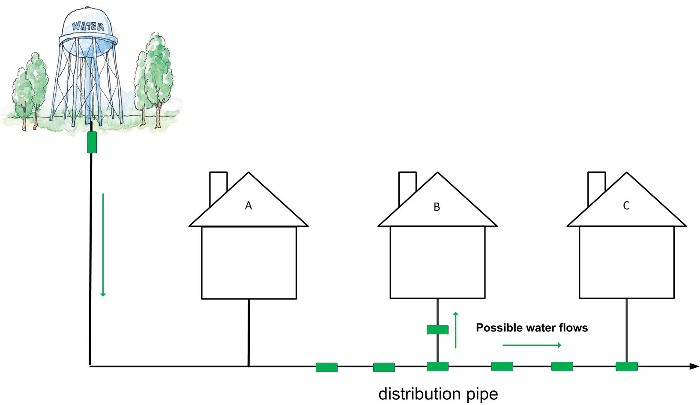


Information Present in the Physical Entity

Slide 28
Information Flow Models
A CPS performs physical actions that are observable
Should keep these secret – loss of confidentiality/privacy
Should not keep these secret – loss of integrity
Some models
Non-interference – Goguen and Messegeur 1982
High-level events do not interfere with the low level outputs
Non-inference – O’Halloran 1990
Removing high-level events leaves a valid system trace
Non-deducibility – Sutherland 1986
Low-level observation is compatible with any of the high-level inputs.

Slide 29
Information Present in the Physical Entity (Non-interference view)
Command Actions Blocked
Command
Not a good model for CPS

Slide 30
Information Flow Models
A CPS performs physical actions that are observable
Should keep these secret – loss of confidentiality/privacy
Should not keep these secret – loss of integrity
Some models
Non-interference – Goguen and Messegeur 1982
High-level events do not interfere with the low level outputs
Non-inference – O-Halloran 1990
Removing high-level events leaves a valid system trace
Non-deducibility – Sutherland 1986
Low-level observation is compatible with any of the high-level inputs.

Slide 31

Information Present in the Physical Entity (Non-inference view)
Potentially a good model for CPS
Command

Slide 32
Information Flow Models
A CPS performs physical actions that are observable
Should keep these secret – loss of confidentiality/privacy
Should not keep these secret – loss of integrity
Some models
Non-interference – Goguen and Messegeur 1982
High-level events do not interfere with the low level outputs
Non-inference – O-Halloran 1990
Removing high-level events leaves a valid system trace
Non-deducibility – Sutherland 1986
Low-level observation is compatible with any of the high-level inputs.

Slide 33
Information Present in the Physical Entity (Non-deducibility view)
A good model for CPS
Command

Slide 34
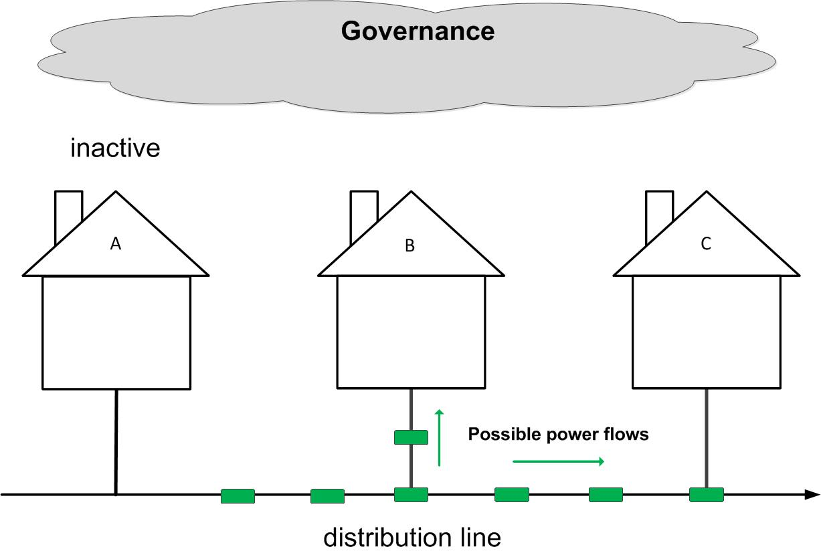
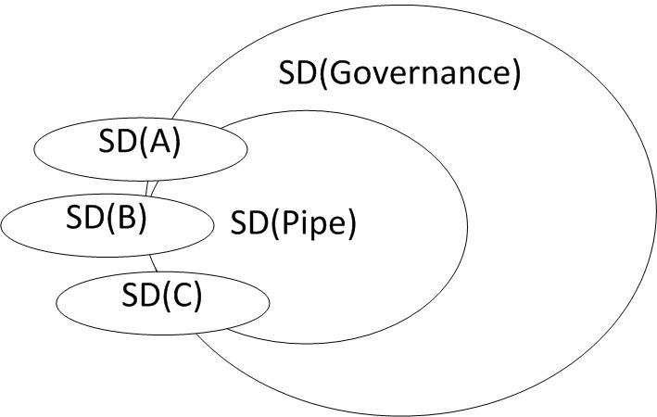
The overlapping security domains in a CPS environment.
Deducible
Non-Deducible
Non-Deducible

Slide 35
Noninference

Slide 36
Noninference

Slide 37
Noninference

Slide 38
Noninference

Slide 39
CS 6600 – Computer Security
Chapter 9 – Information Flow
Bruce McMillin
Department of Computer Science
Missouri University of Science and Technology
325 Computer Science, 500 W. 15th St., Rolla, MO 65409
o/ (573) 341-6435 e/ ff@mst.edu

